Slide 1



Slide 2
Your Coding mentor

Slide 3
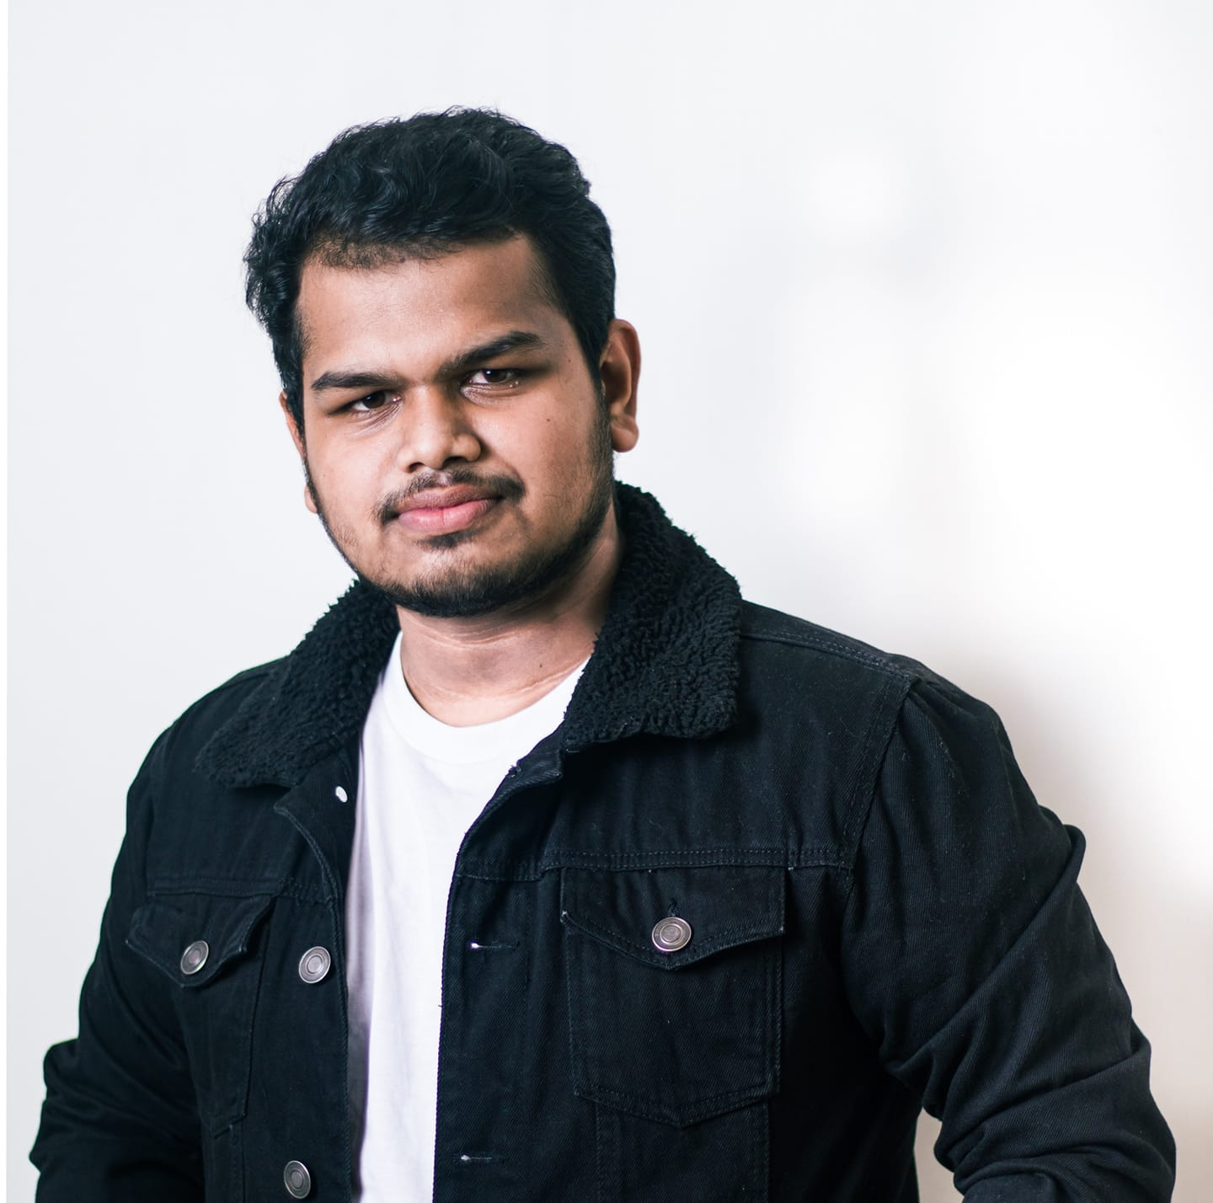


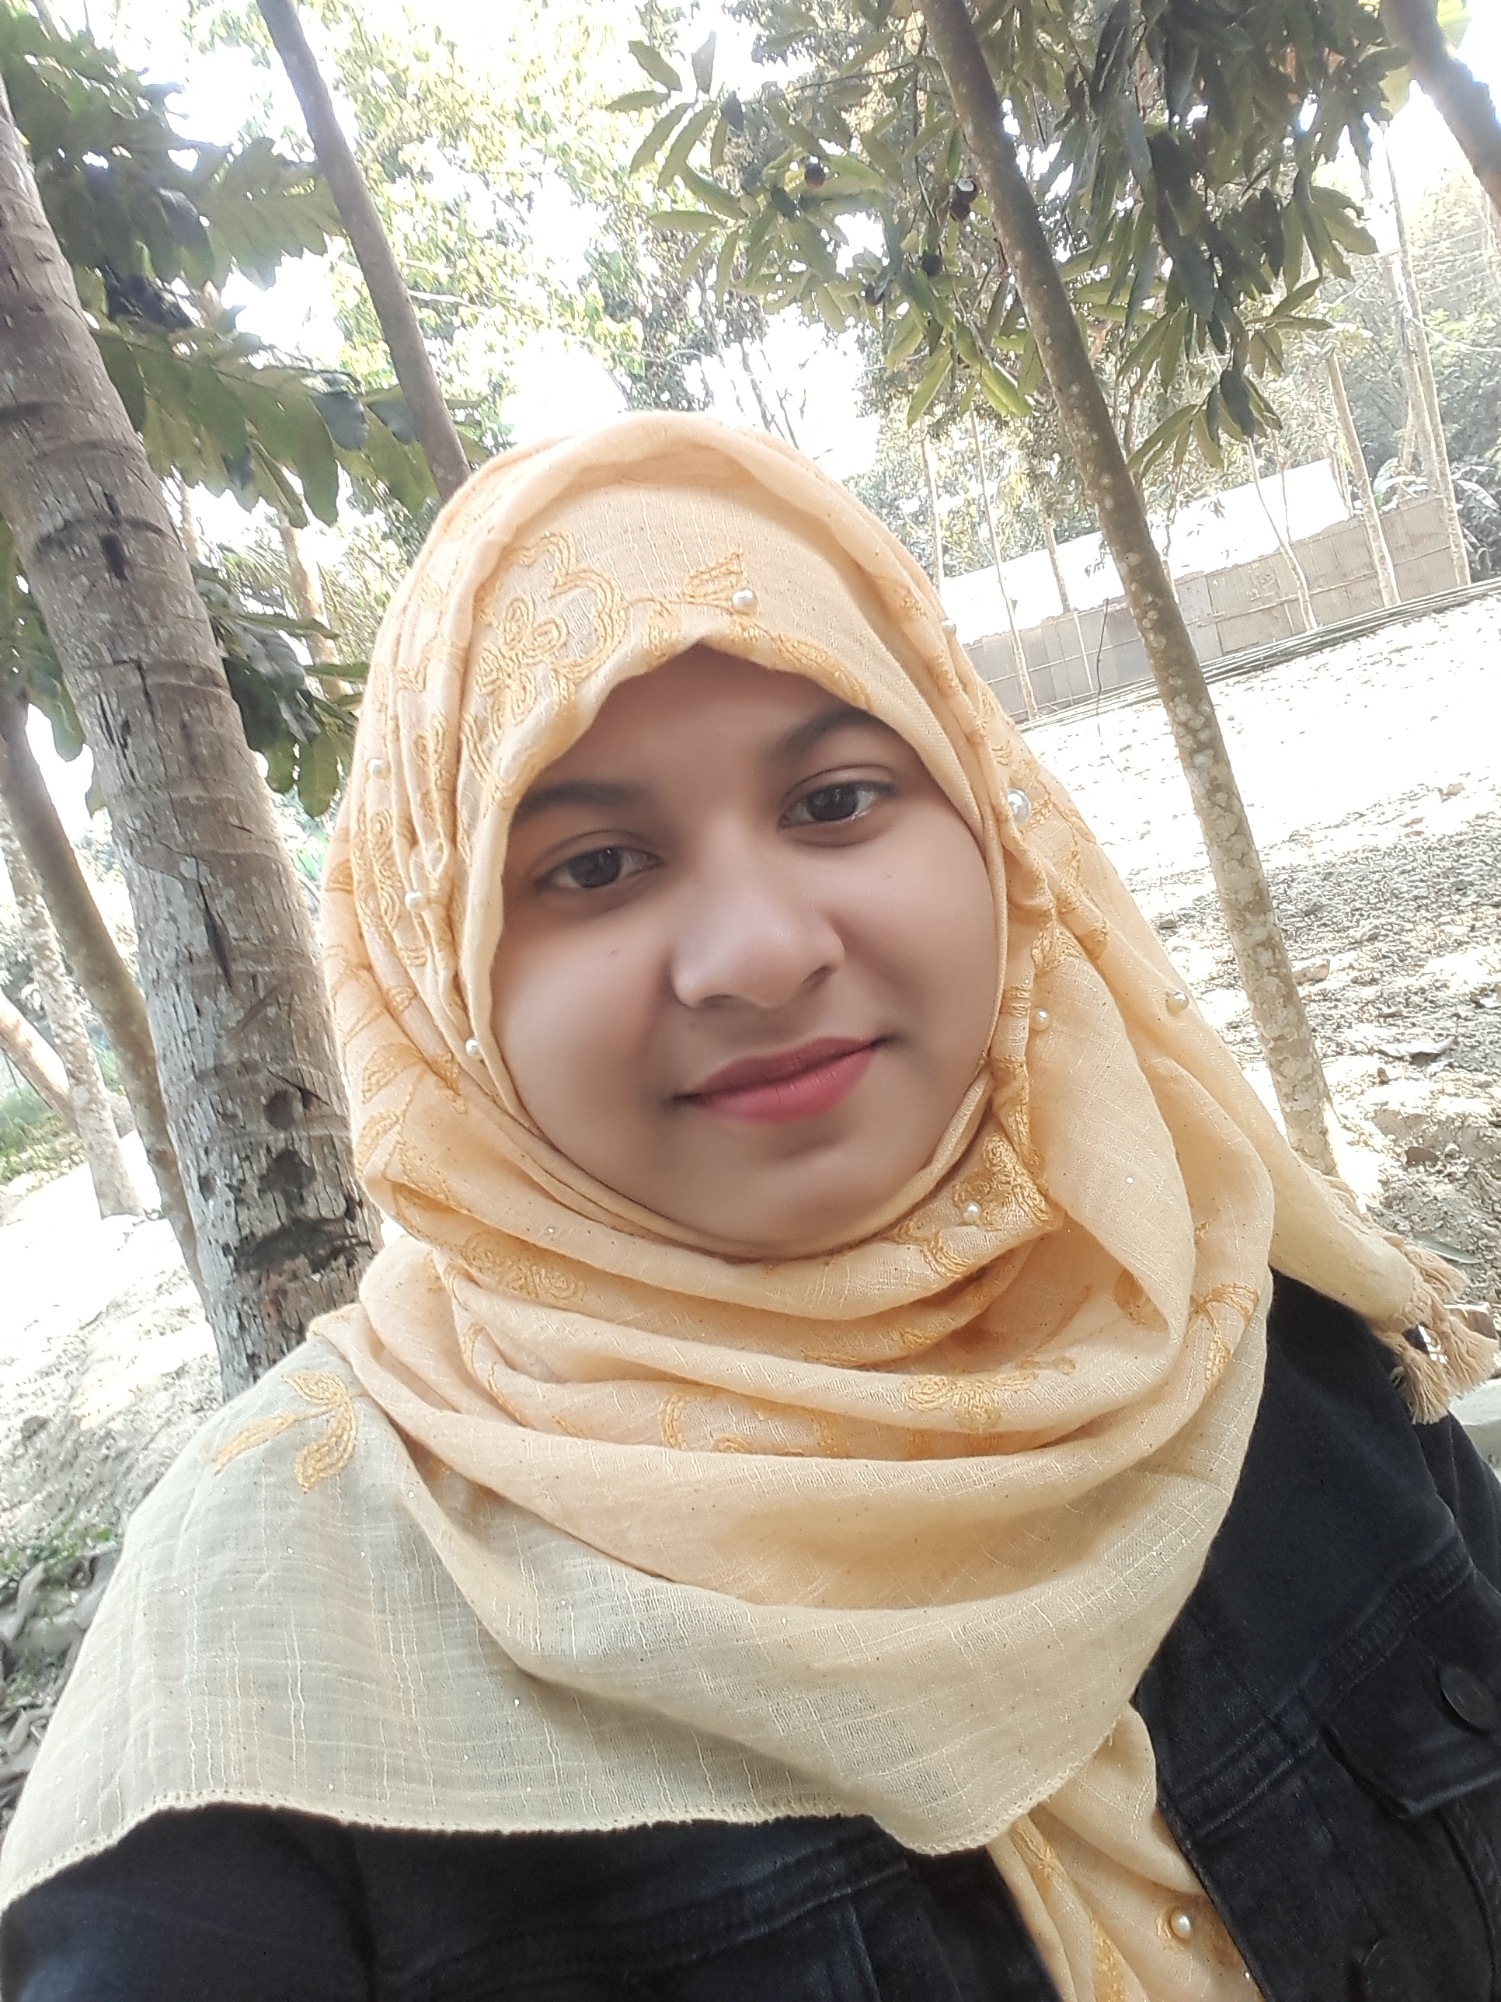

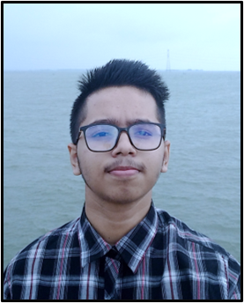

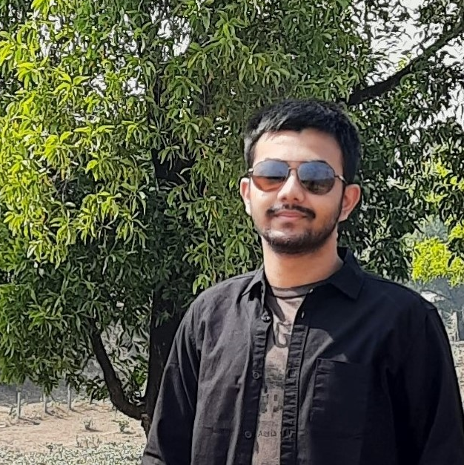



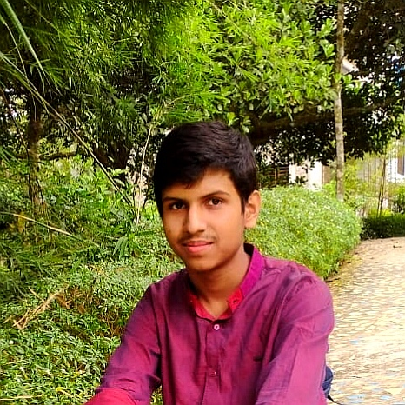


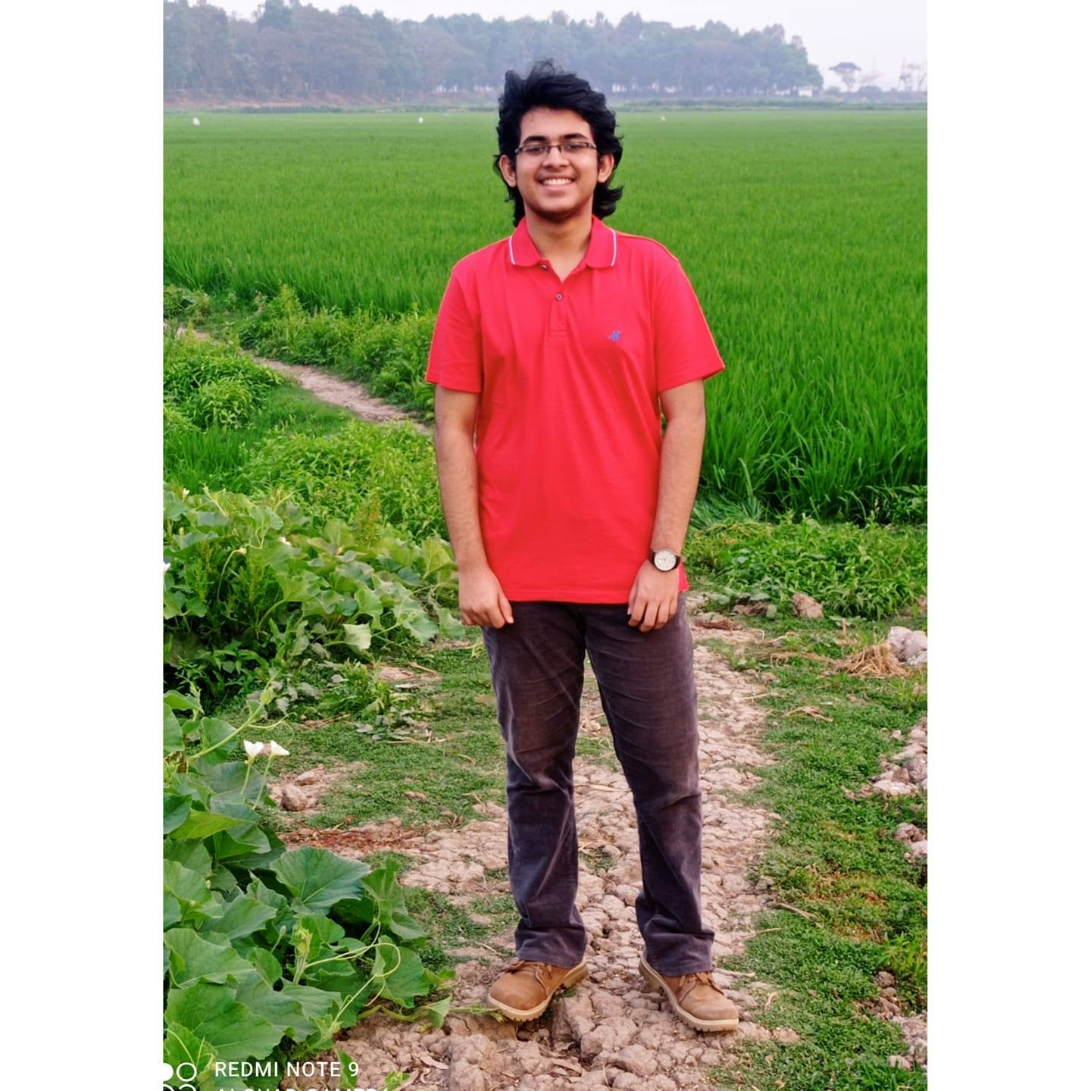

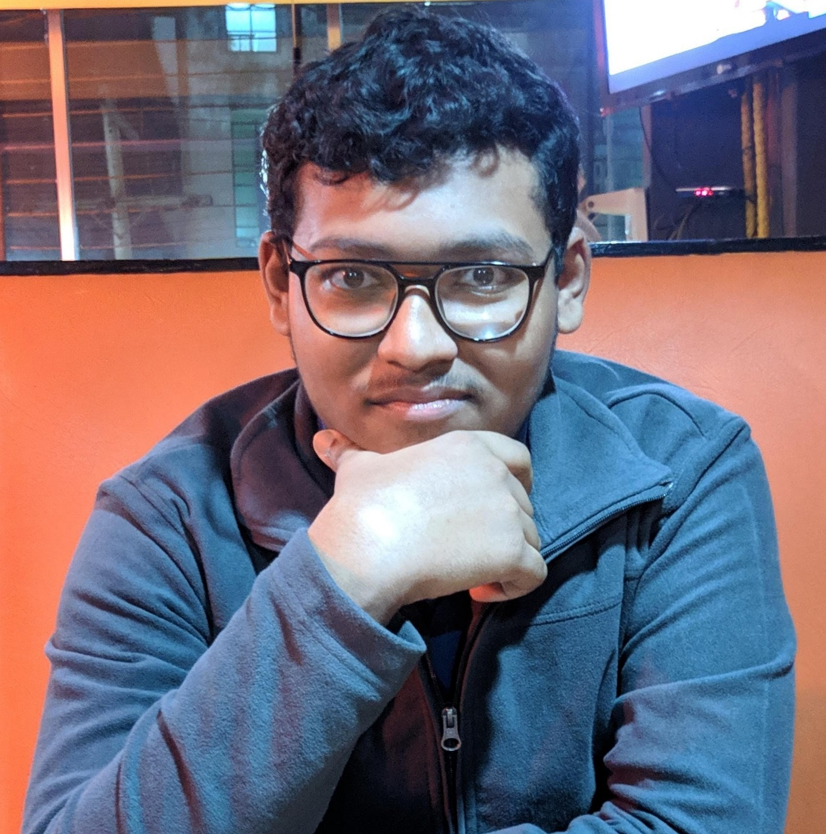


Slide 4
THE LEARNING CONE
10% of what you READ
10%
20%
20% of what you SEE
30%
30% of what you HEAR
70%
70% of what you SAY
90%
90% of what you D0

Slide 5
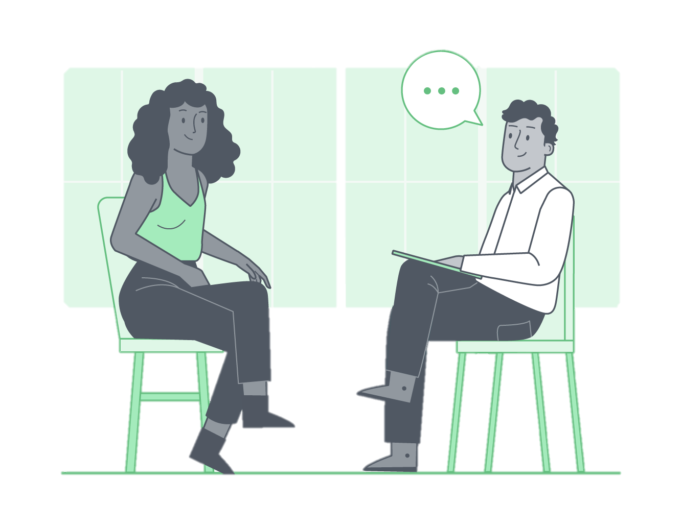

Slide 6






Learn with Sumit
VISION GREEN
ORGANIZATION

